Slide 1
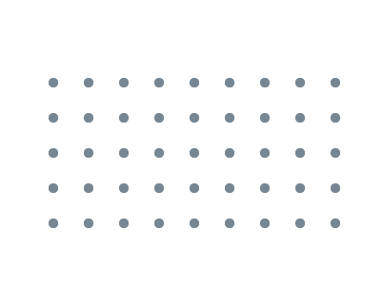


Slide 2


Dmytro Shcherbatiuk
I'm software engineer with years of experience in Java.
I love to work on challenging tasks, distributed systems, prefer active sports like, tennis and snowboarding and like programming on an Elixir/Rust lang.

Slide 3
Plan
07
Java NIO (Client/Server)
01
08
Queueing in the Linux network stack
TCP Data Flow and Window Management
Network Layers
Queueing in the Linux network stack
02
09
Network Layers
Secure sockets (Java SSLEngine)
The Architecture and Protocols of the TCP/IP Suite
03
The Architecture and Protocols of the TCP/IP Suite
10
TCP Data Flow and Window Management
Questions
The disadvantages of the TCP protocol
04
The disadvantages of the TCP protocol
Couple words about QUIC protocol
Network Sockets
05
Couple words about QUIC protocol
Java NIO (Client/Server)
Secure sockets (Java SSLEngine)
06
Java NIO Performance
Network Sockets
Questions
Topics for further events

Slide 4
Network Layers
Queueing in the Linux network stack
Queueing in the Linux network stack
The Architecture and Protocols of the TCP/IP Suite
TCP Data Flow and Window Management
The disadvantages of the TCP protocol
Couple words about QUIC protocol
Network Sockets
Java NIO (Client/Server)
Secure sockets (Java SSLEngine)
Java NIO Performance
Questions
Topics for further events

Slide 5
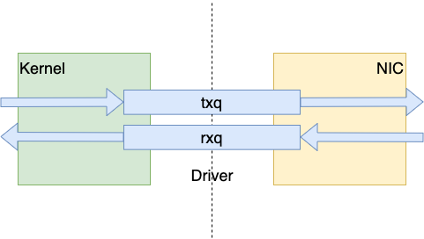
NIC – Network Interface Controller

Slide 6
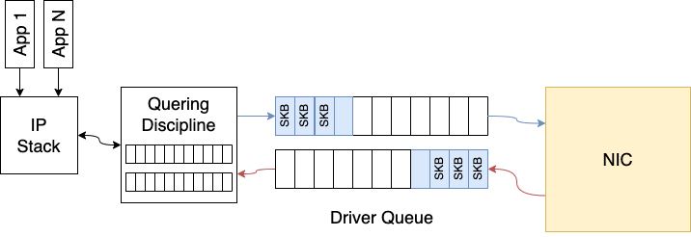
Queueing in the network stack?

Slide 7
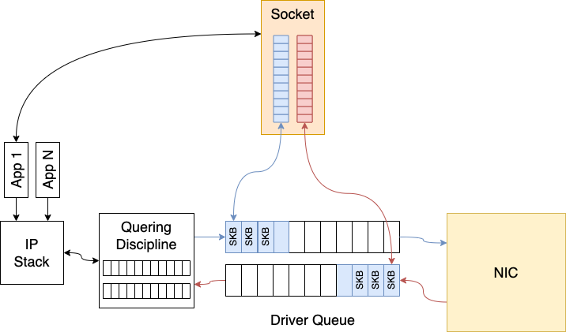
Queueing in the network stack?

Slide 8
Driver Queue
Between the IP stack and the network interface controller (NIC) lies the driver queue.
This queue is typically implemented as a first-in, first-out (FIFO) ring buffer.
The driver queue does not contain packet data. Instead it consists of descriptors which point to other data structures called socket kernel buffers (SKBs) which hold the packet data and are used throughout the kernel.

Slide 9
Starvation
If the NIC driver wakes to pull packets off of the queue for transmission and the queue
is empty the hardware will miss a transmission opportunity thereby reducing the throughput of the system. This is referred to as starvation.
Note that an empty queue when the system does not have anything to transmit is not starvation – this is normal.
The complication associated with avoiding starvation is that the IP stack which is filling
the queue and the hardware driver draining the queue run asynchronously.
Worse, the duration between fill or drain events varies with the load on the system
and external conditions such as the network interface’s physical medium.
For example, on a busy system the IP stack will get fewer opportunities to add packets
to the buffer which increases the chances that the hardware will drain the buffer before
more packets are queued. For this reason it is advantageous to have a very large buffer
to reduce the probability of starvation and ensures high throughput.
For this reason it is advantageous to have a very large buffer to reduce the probability
of starvation and ensures high throughput.

Slide 10
Latency
While a large queue is necessary for a busy system to maintain high throughput, it has the downside of allowing for the introduction of a large amount of latency.

Slide 11
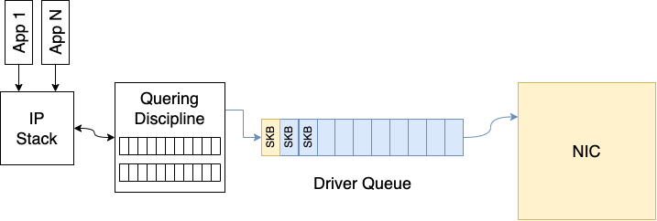
Latency
A network interface which is capable of transmitting at 5 Mbit/sec or 5,000,000 bits/sec.
Each packet from the bulk flow is 1,500 bytes or 12,000 bits.
The depth of the queue is 128 descriptors
There are 127 bulk data packets and 1 interactive packet queued last.
The time required to drain the 127 bulk packets and create a transmission opportunity for the interactive packet is (127 * 12,000) / 5,000,000 = 0.304 seconds (304 milliseconds for those who think of latency in terms of ping results).

Slide 12
Network Layers

Slide 13
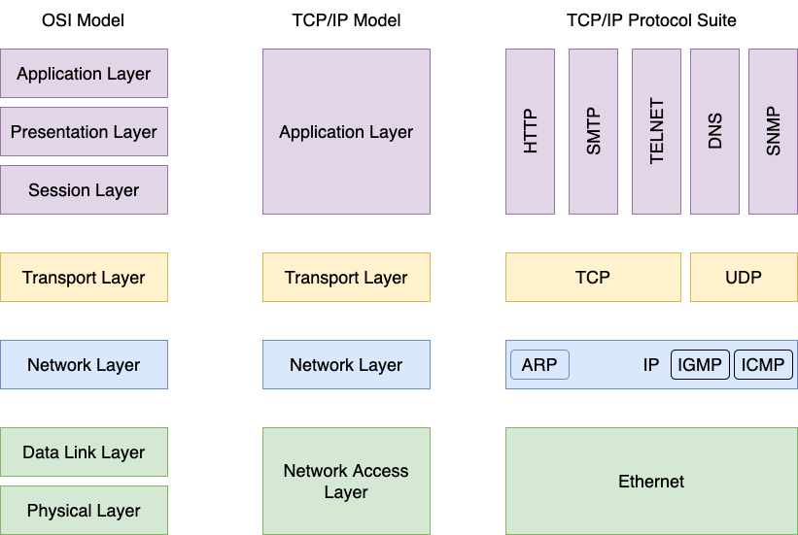

Slide 14
The Architecture and Protocols of the TCP/IP Suite

Slide 15
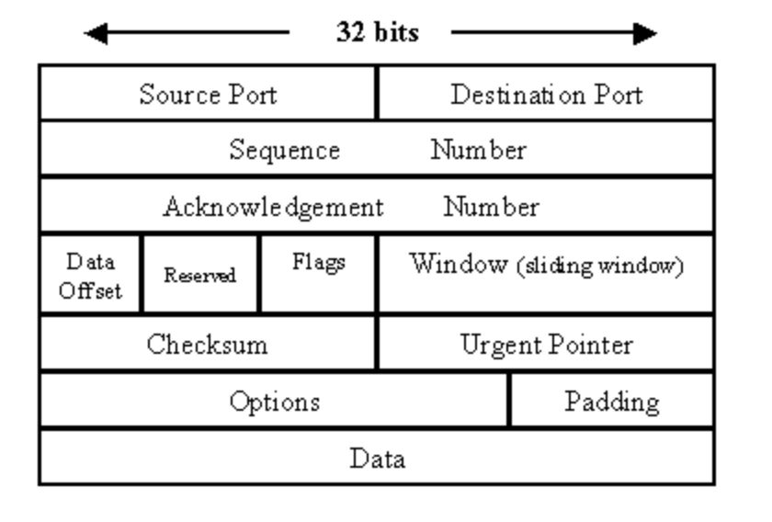
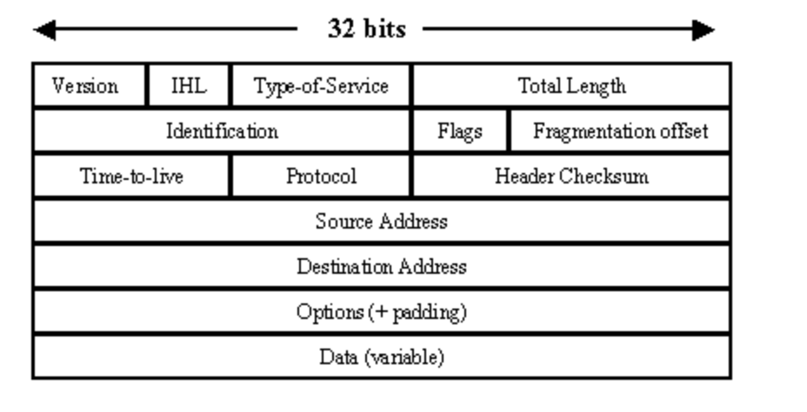
Transport Layer L4
Network Layer L3
TCP Packet
IP Packet

Slide 16
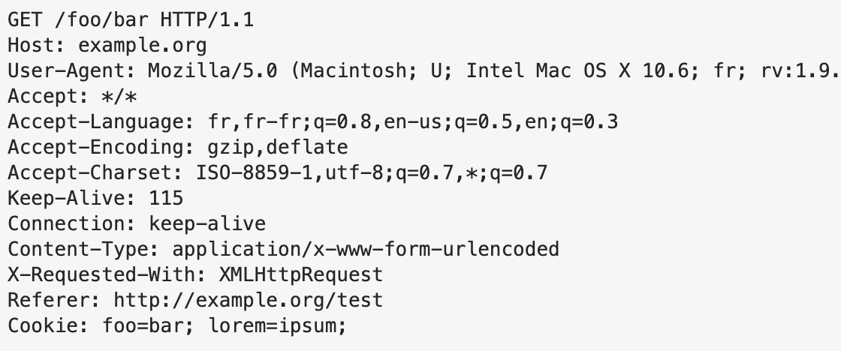
Transport Layer L5-6
Transport Layer L4
Http 1.1 Request
TCP Packet

Slide 17
The disadvantages of the TCP protocol

Slide 18
The disadvantages of the TCP protocol
Hard to deploy updates for TCP because it is built into the operating systems (OS) of computers. For TCP to be updated, a new OS version has to be deployed.
This can be difficult to achieve as companies can be cautious with releasing a new OS update and choosing features to include in the release.
Another problem is the widespread hardware that uses TCP. Studies have shown that
it takes a considerable amount of time for updates to cascade down to every node in a network. Furthermore, users might fall behind in updating the OS after a release has been made. With users employing a variety of TCP versions, potential bugs or malfunctions may arise.
TCP head of line blocking. TCP works with data as with a stream of bytes.
When a single packet in the stream is lost, no stream on that connection can make
forward progress until that one packet is retransmitted. On the other hand, packet loss
in one stream in QUIC doesn’t affect other streams.

Slide 19
Couple words about QUIC protocol

Slide 20
Why QUIC?
QUIC is an acronym for Quick UDP Internet Connections and was designed by Google.
Currently, it is maintained by IETF as several RFC documents currently standardize the QUIC protocol. The primary purpose of the QUIC protocol is to improve the user experience (mainly reduce web page load times) compared to the connections using TCP+TLS+HTTP/2 protocols.
QUIC is a relatively new transport layer network protocol that has gained popularity over
the last few years.
Even though QUIC was implemented with an orientation to web applications,
it is a general-purpose transport protocol that can be used for any network application. As its name says, it is based on the UDP protocol and uses port 443.
Because the UDP is a connectionless protocol without guaranteed delivery,
it is up to the QUIC protocol to implement all necessary mechanisms to ensure correct data delivery.

Slide 21
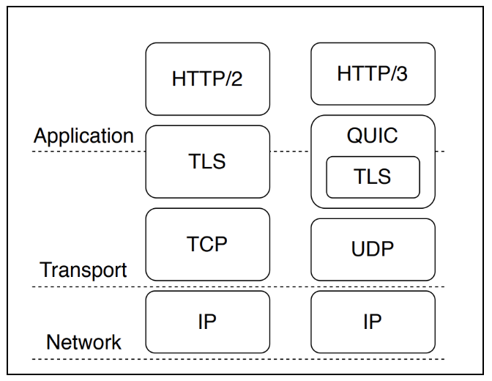

Slide 22
QUIC is always secure. There is no clear-text version of the protocol so to negotiate
a QUIC connection means doing cryptography and security with TLS 1.3. As mentioned above, this prevents ossification as well as other sorts of blocks and special treatments,
as well as making sure QUIC has all the secure properties of HTTPS that web users have come to expect and want. There are only a few initial handshake packets that are sent in
the clear before the encryption protocols have been negotiated.
QUIC offers both 0-RTT and 1-RTT handshakes that reduce the time it takes to negotiate
and setup a new connection. Compare with the 3-way handshake of TCP. In addition to that, QUIC offers "early data" support from the get-go which is done to allow more data and it is used more easily than TCP Fast Open. With the stream concept, another logical connection to the same host can be done at once without having to wait for the existing one to end first.

Slide 23
Transfer protocol over UDP. QUIC is a transfer protocol implemented on top of UDP.
If you watch your network traffic casually, you will see QUIC appear as UDP packets. Based on UDP it also then uses UDP port numbers to identify specific network services on a given IP address. All known QUIC implementations are currently in user-space,
which allows for more rapid evolution than kernel-space implementations typically allow.
Reliable. While UDP is not a reliable transport, QUIC adds a layer on top of UDP
that introduces reliability. It offers re-transmissions of packets, congestion control,
pacing and the other features otherwise present in TCP. Data sent over QUIC from one end-point will appear in the other end sooner or later, as long as the connection is maintained.

Slide 24
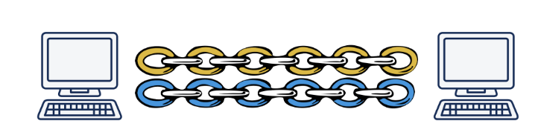
Streams. Similar to HTTP/2, QUIC features separate logical streams within the physical connections. A number of parallel streams that can transfer data simultaneously over a single connection without affecting the other streams. A connection is a negotiated setup
between two end-points similar to how a TCP connection works. A QUIC connection is made to a UDP port and IP address, but once established the connection is associated by its "connection ID".Over an established connection, either side can create streams and send data to the other end. Streams are delivered in-order and they are reliable, but different streams may be delivered out-of-order.
QUIC offers flow control on both connection and streams.
QUIC guarantees in-order delivery of streams, but not between streams. This means that each stream will send data and maintain data order, but each stream may reach the destination in a different order than the application sent it!

Slide 25
Fast handshakes. QUIC offers both 0-RTT and 1-RTT connection setups, meaning that
at best QUIC needs no extra round-trips at all when setting up a new connection.
The faster of those two, the 0-RTT handshake, only works if there has been
a previous connection established to a host and a secret from that connection has been cached.
The transport security used in QUIC is using TLS 1.3 and there are never
any unencrypted QUIC connections. TLS 1.3 has several advantages compared
to older TLS versions but a primary reason for using it in QUIC is that 1.3
changed the handshake to require fewer roundtrips. It reduces protocol latency.

Slide 26
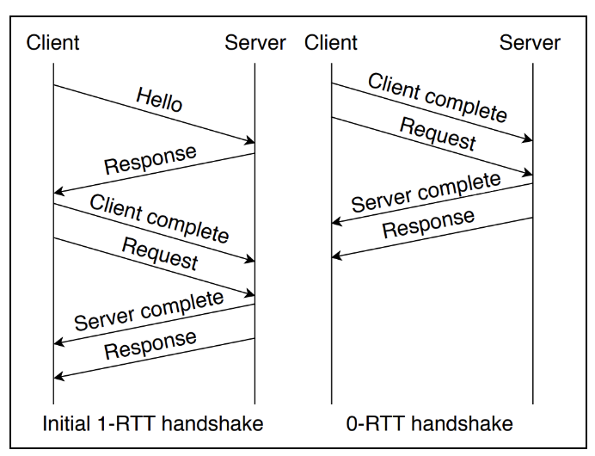
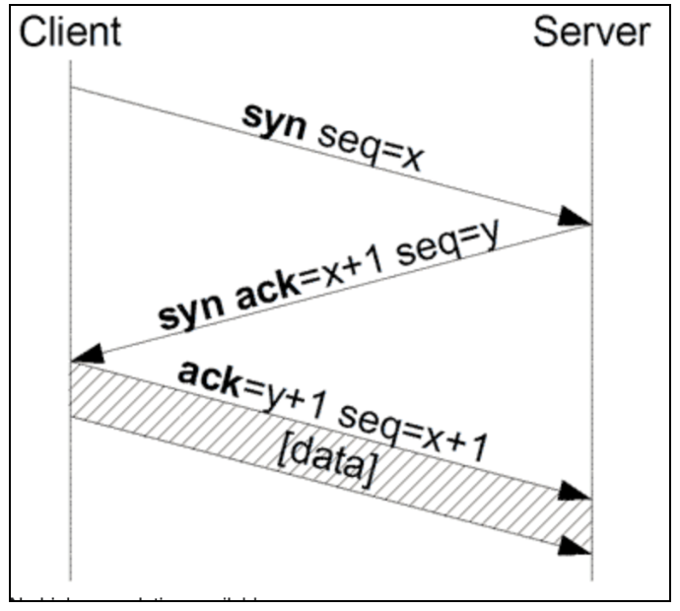
Faster connection establishment

Slide 27
Network Sockets

Slide 28
Socket communication domains
AF_INET – IPv4 Internet Domain
AF_INET6 – IPv6 Internet Domain
AF_UNIX – UNIX domain
SOCK_DGRAM – fixed-length, connectionless, unreliable messages
SOCK_RAW – datagram interface to IP
SOCK_SEQPACKET - fixed-length, sequenced, reliable, connection-oriented messages
SOCK_STREAM - sequenced, reliable, bidirectional, connection-oriented byte messages
Java supports only SOCK_STREAM and SOCK_DGRAM

Slide 29
SOCK_DGRAM
With a datagram (SOCK_DGRAM) interface, no logical connection needs to exist between peers for them to communicate. All you need to do is send a message addressed to the socket being used by the peer process.
A datagram is a self-contained message. Sending a datagram is analogous to mailing
someone a letter. You can mail many letters, but you can’t guarantee the order of delivery, and some might get lost along the way. Each letter contains the address of the recipient, making the letter independent from all the others. Each letter can even go to different recipients.
The default protocol for a SOCK_DGRAM socket in the AF_INET communication domain
is UDP (User Datagram Protocol).

Slide 30
SOCK_STREAM
A SOCK_STREAM socket provides a byte-stream service;
applications are unaware of message boundaries.
This means that when we read data from a SOCK_STREAM socket,
it might not return the same number of bytes written by the sender.
We will eventually get everything sent to us, but it might take several function calls.
The default protocol for a SOCK_STREAM socket in the AF_INET communication domain
is TCP (Transmission Control Protocol).

Slide 31
SOCK_SEQPACKET
A SOCK_SEQPACKET socket is just like a SOCK_STREAM socket except that
we get a message-based service instead of a byte-stream service.
This means that the amount of data received from a SOCK_SEQPACKET socket is the same amount as was written.
The Stream Control Transmission Protocol (SCTP) provides a sequential packet service in the Internet domain.

Slide 32
SOCK_RAW
A SOCK_RAW socket provides a datagram interface directly to the underlying network layer (which means IP in the Internet domain). Applications are responsible for building their own protocol headers when using this interface, because the transport protocols (TCP and UDP, for example) are bypassed. Superuser privileges are required to create a raw socket to prevent malicious
applications from creating packets that might bypass established security mechanisms.
The Stream Control Transmission Protocol (SCTP) provides a sequential packet service in the Internet domain.

Slide 33
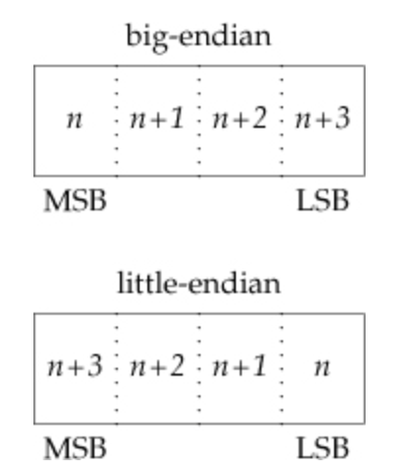
Byte Ordering
The byte order is a characteristic of the
processor architecture, dictating how bytes
are ordered within larger data types.

Slide 34
Java NIO (Client/Server)

Slide 35
Based on Reactor/dispatcher Pattern
The reactor design pattern was introduced as a general architecture
to implement event-driven systems.
To solve our original problem of implementing a server application
that can handle thousands of simultaneous client connections,
Reactor pattern provides a way in which we can listen to the events
(incoming connections/requests) with a synchronous demultiplexing strategy
so that when an incoming event occurs, it is dispatched to a service provider (handler) that can handle this event.

Slide 36
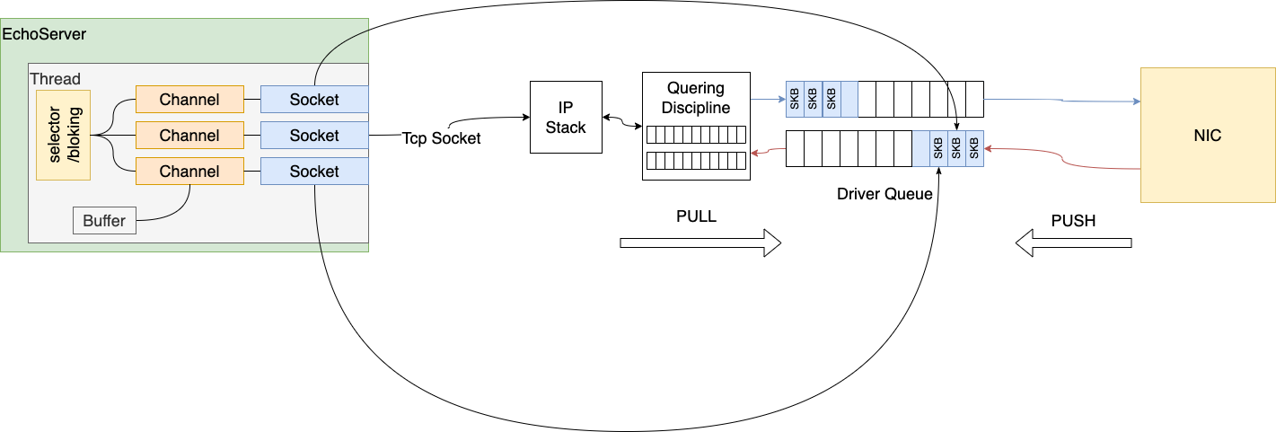

Slide 37
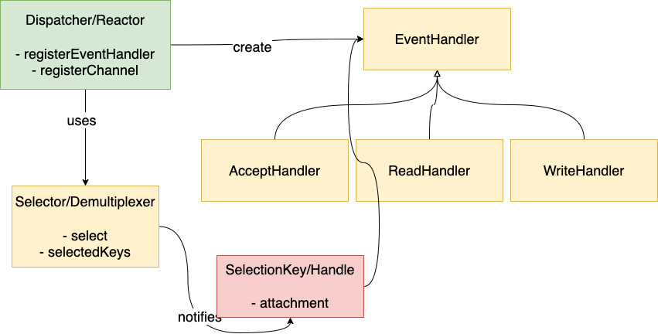
Reactor Pattern diagram

Slide 38
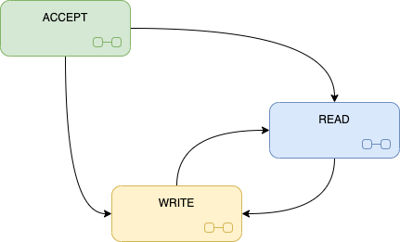
Java NIO States

Slide 39
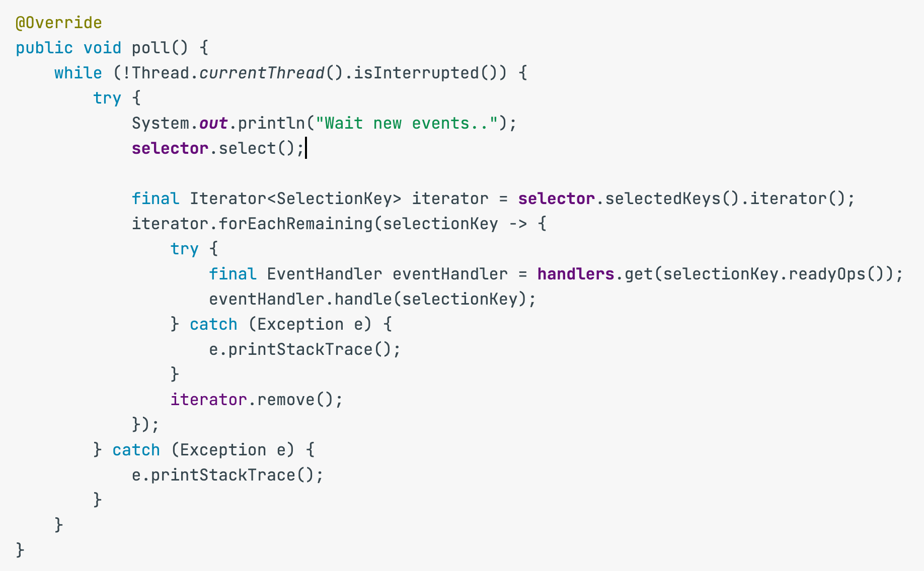
Reactor/Poller

Slide 40
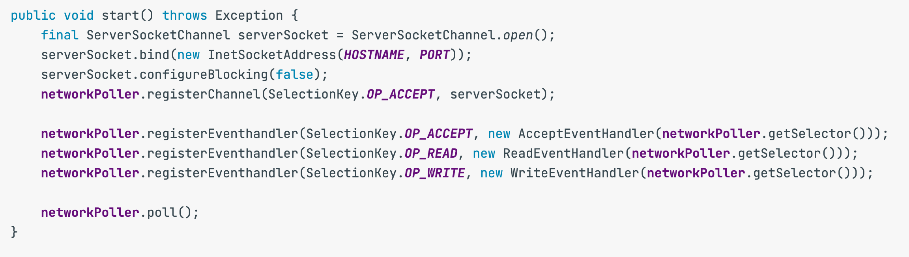
Tcp Server

Slide 41
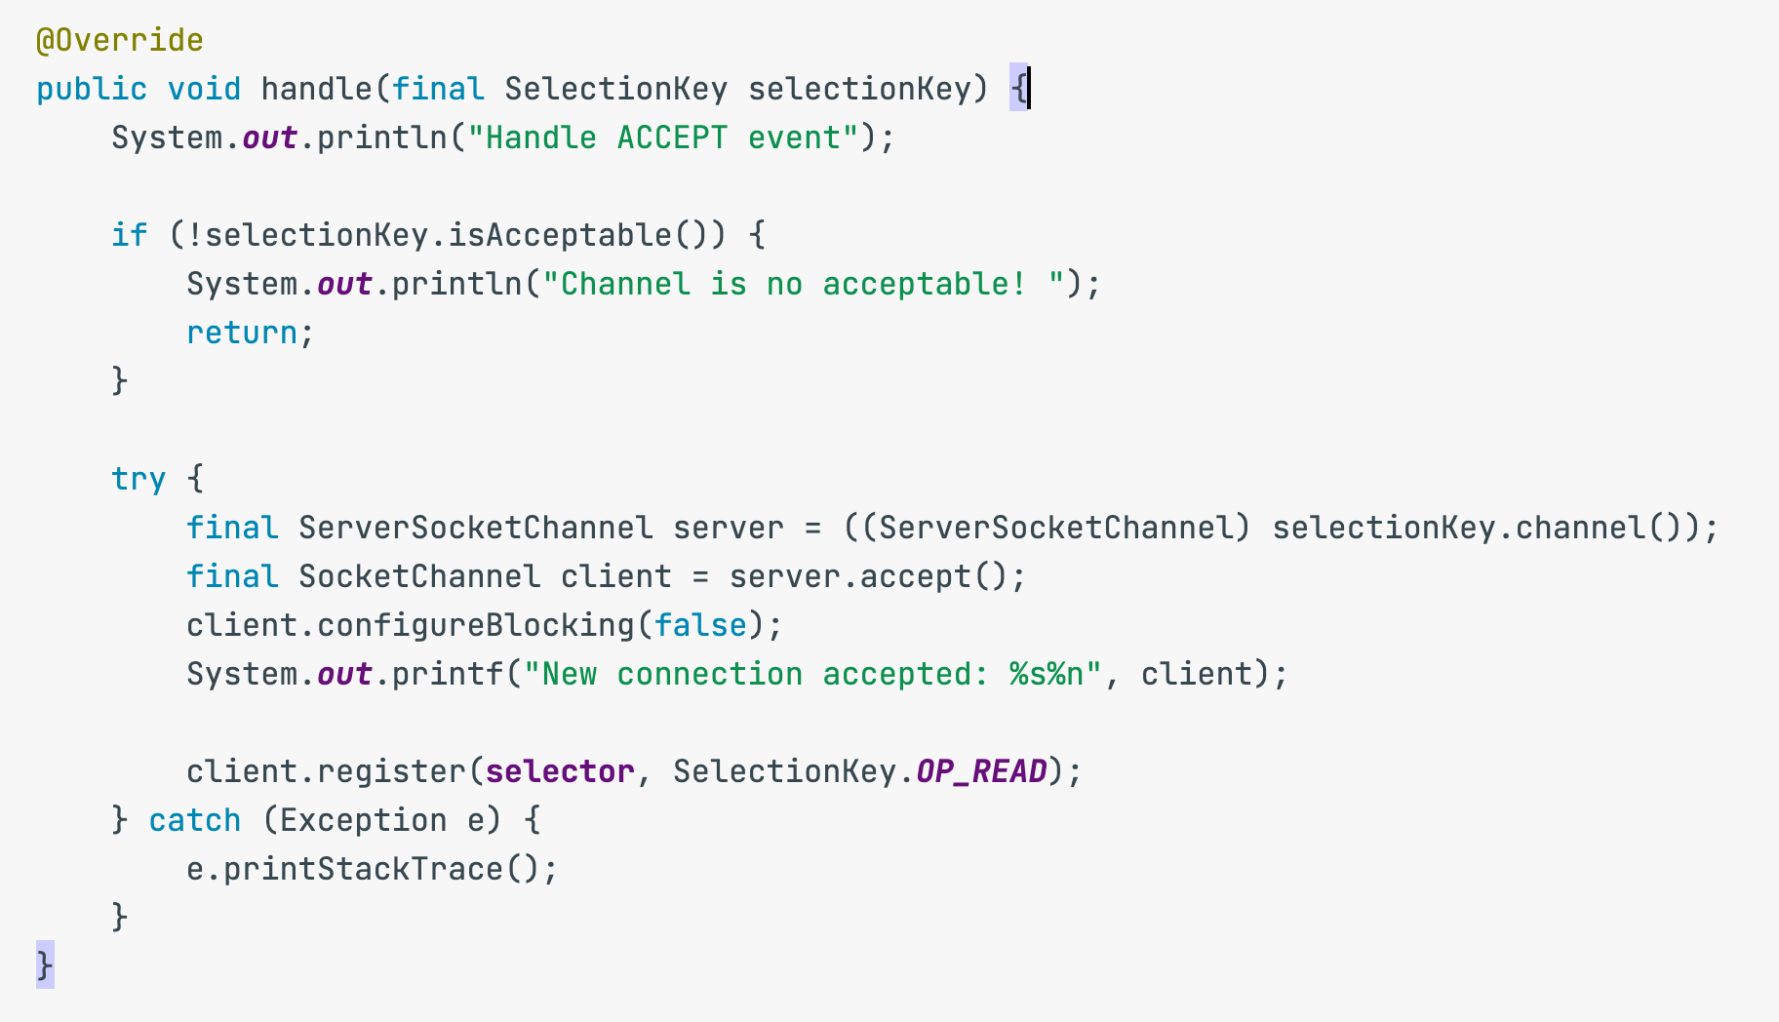
Accept Event Handler

Slide 42
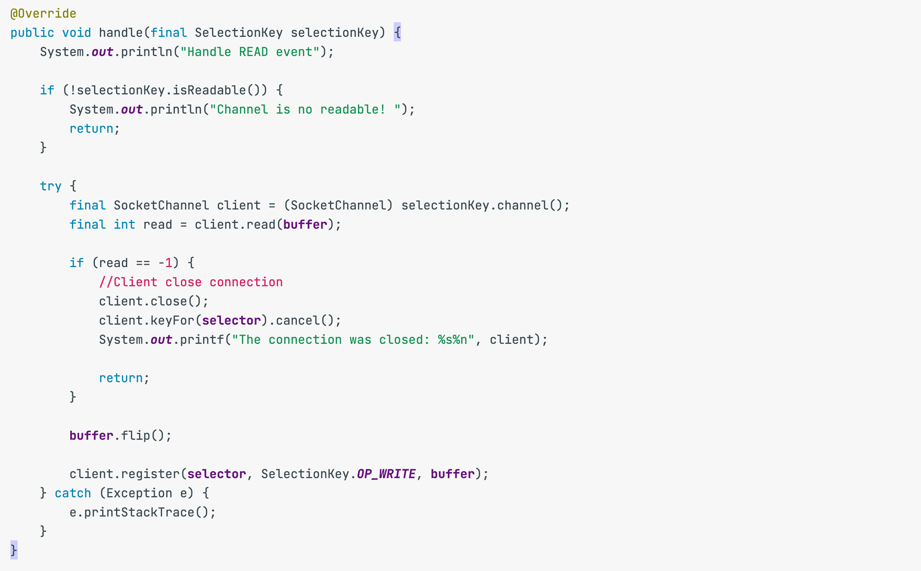
Read Event Handler

Slide 43
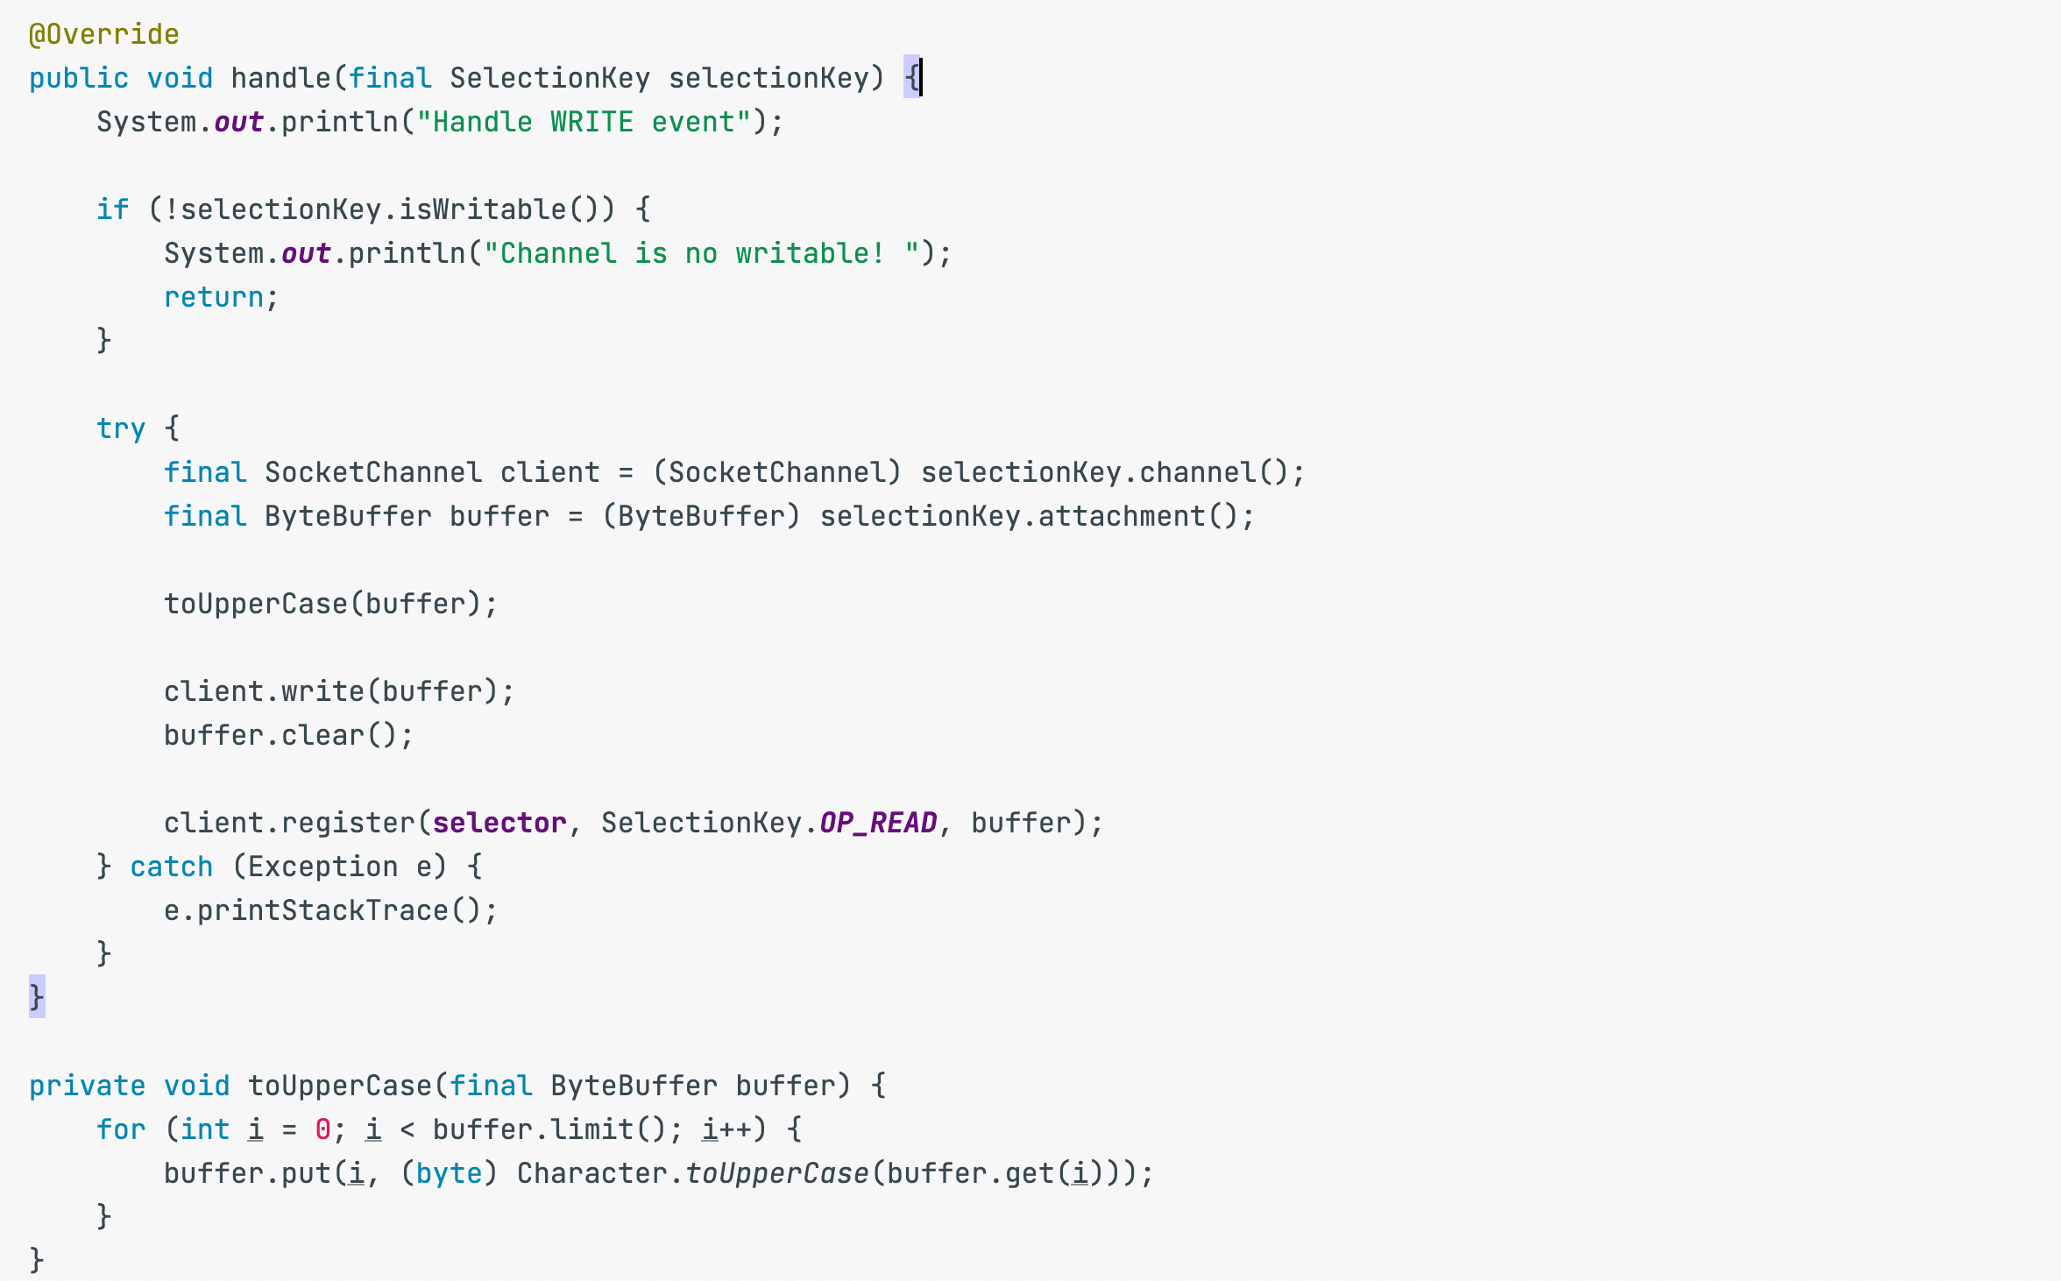
Write Event Handler

Slide 44
Reactor pattern Components
Selector/Demultiplexer works in synchronous mode to waiting on the events to occurs on the handlers. This is a synchronous blocking behavior, but this only blocks when we do not have events queued up at the handles. In all other cases, when there is
an event for a given handle, demultiplexer notifies the initiation dispatcher to call-back the appropriate event handler. A very common realization of a demultiplexer in Unix is the ‘select(.)’ system call, which is used to examine the status of file descriptors in Unix.
Dispatcher/Reactor
Initiation dispatcher provides an API for registering, removing, and dispatching of
event handler objects. Therefore, various types of event handlers are registered
with the initiation dispatcher and it also initiates the demultiplexer so that
it can receive notifications when the demultiplexer detects any event.
When events such as connection acceptance, data input/output, timeout,
etc. have occurred at the demultiplexer, it then notifies the initiation dispatcher.
Thereafter, the initiation dispatcher invokes the respective concrete event handler.

Slide 45
Reactor pattern Components
Event handler is merely an interface that represents dispatching operation for a specific event.
Concrete event handler is derived from the abstract event handler and each implementation comprises a specific method of processing a specific event type. It is important to keep in mind that these concrete event handlers are often run on a dedicated thread pool, which is independent from the initiation dispatcher and the demultiplexer.
There are Acceptable, Readable, Writable handlers

Slide 46
TCP Data Flow and Window Management

Slide 47
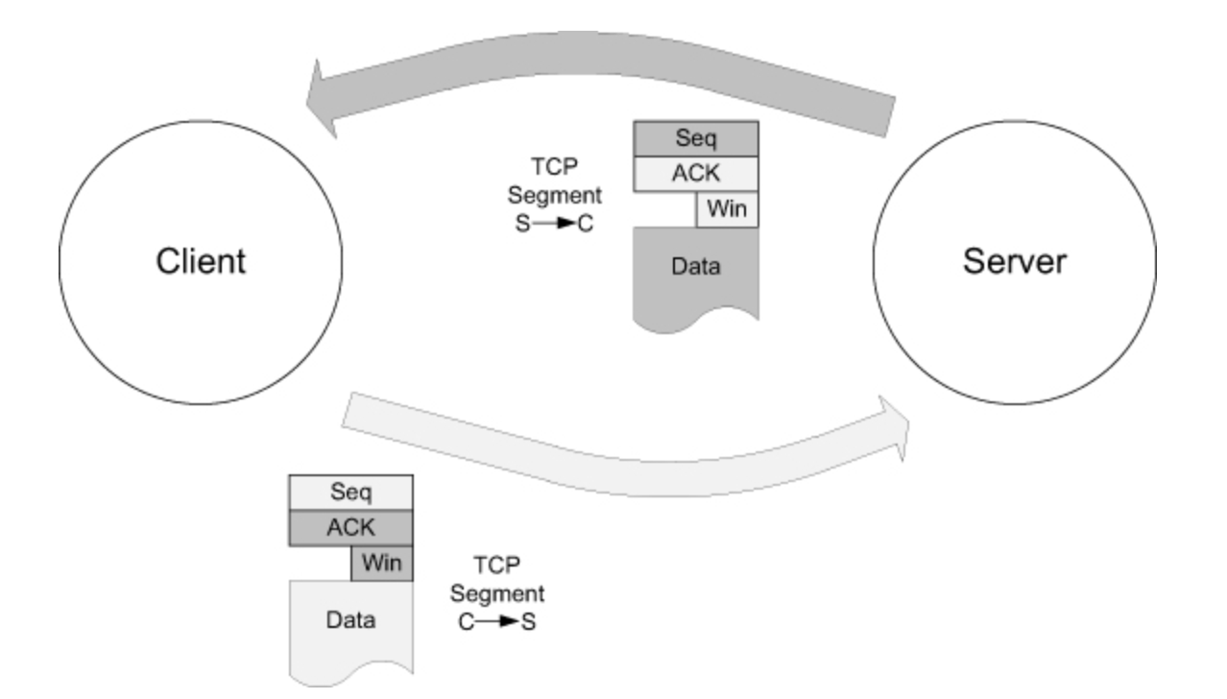
A TCP client and server are interacting, providing each other with information about the data flow, including segment sequence numbers, ACK numbers, and window sizes (i.e., available space at the receiver).

Slide 48
Data flowing in the C→S direction is included in segments flowing along the bottom arrow, but the ACK number and window advertisement for this data are returned in segments following the top arrow.
Every TCP segment (except those exchanged during connection establishment) includes a valid Sequence Number field, an ACK Number or Acknowledgment field, and a Window Size field (containing the window advertisement).

Slide 49
When TCP starts to queue data in this way, the amount of space available to hold new incoming data decreases, and this change is reflected by a decreasing value of the Window Size field. Eventually, if the application does not read or otherwise consume the data at all, TCP must take some action to cause the sender to cease sending new data entirely, because there would be no place to put it on arrival. This is accomplished by sendinga window advertisement of zero (no space).
The Window Size field in each TCP header indicates the amount of empty space, in bytes, remaining in the receive buffer. The field is 16 bits in TCP,
but with the Window Scale option, values larger than 65,535 can be used
Let’s see it on real example.

Slide 50
What happens when windows reach zero
When the receiver’s advertised window goes to zero, the sender is effectively stopped from transmitting data until the window becomes nonzero. When the receiver once again has space available, it provides a window update to the sender to indicate that data is permitted to flow once again. Because such updates do not generally contain data (they are a form of “pure ACK”), they are not reliably delivered by TCP. TCP must therefore handle the case where such window updates that would open the window are lost.
Let’s see it on real example.

Slide 51
Secure Sockets (Java SSLEngine)

Slide 52
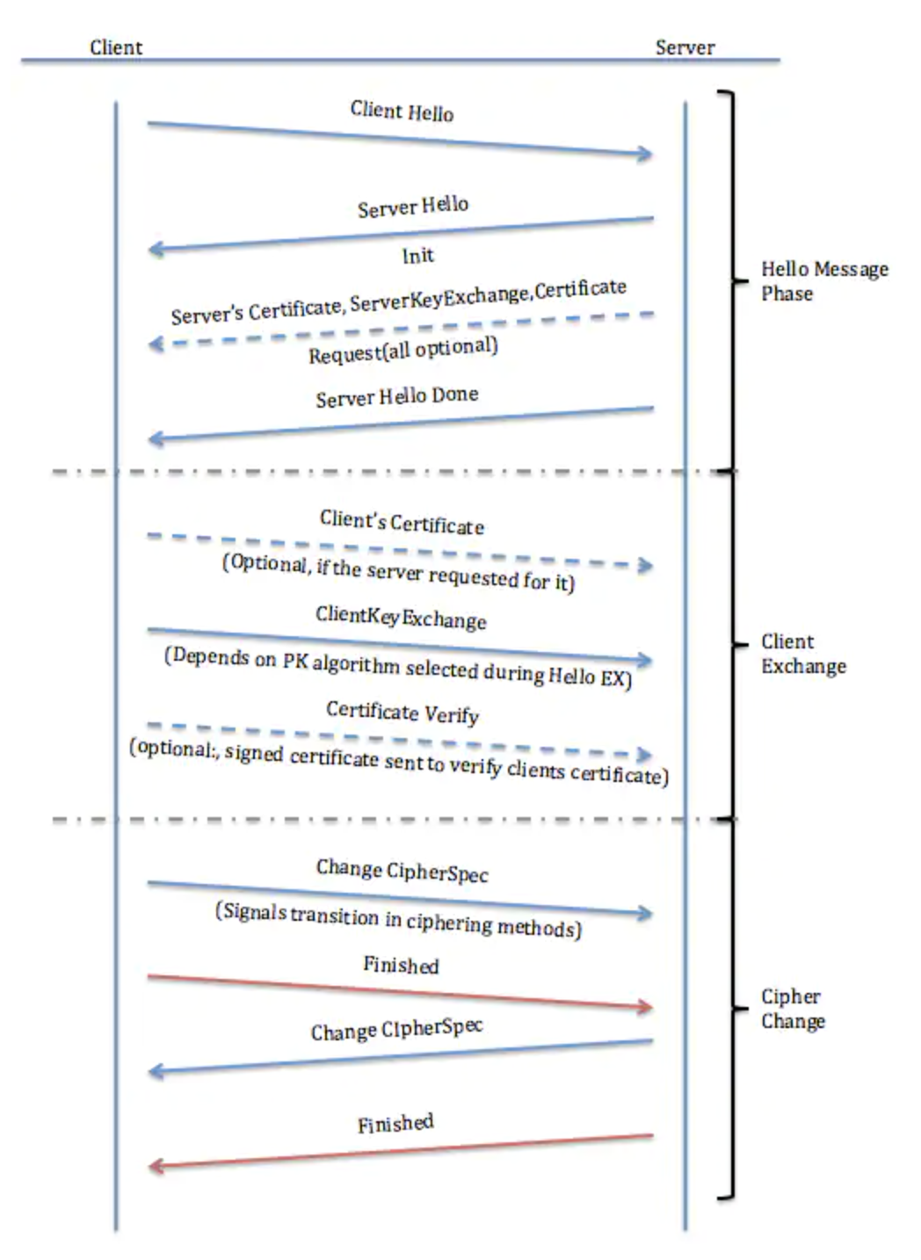
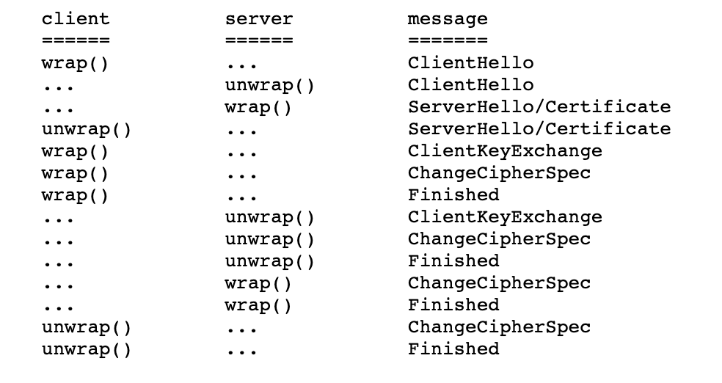

Slide 53
References about BCI:
https://www.coverfire.com/articles/queueing-in-the-linux-network-stack/
https://bootlin.com/blog/multi-queue-improvements-in-linux-kernel-ethernet-mvneta/
https://github.com/kasun04/nio-reactor
https://gee.cs.oswego.edu/dl/cpjslides/nio.pdf
https://jenkov.com/tutorials/java-nio/index.html
https://www.cisco.com/c/en/us/support/docs/security-vpn/secure-socket-layer-ssl/116181-technote-product-00.html
https://docs.oracle.com/javase/8/docs/technotes/guides/security/jsse/samples/sslengine/SSLEngineSimpleDemo.java

Slide 54
Q&A

Slide 55
THANKS YOU!

